Slide 1
CSE 442
Enhancing Medical Question Answering with Retrieval Augmentation and Reranking Transformer Embeddings in Generative Language Models

Slide 2
Group Members:
Shabab Abdullah(20301005)
Tanzir Hossain (20301154)
Ar-Rafi Islam (20301164)
Jannatul Ferdoshi (20301193)

Slide 3
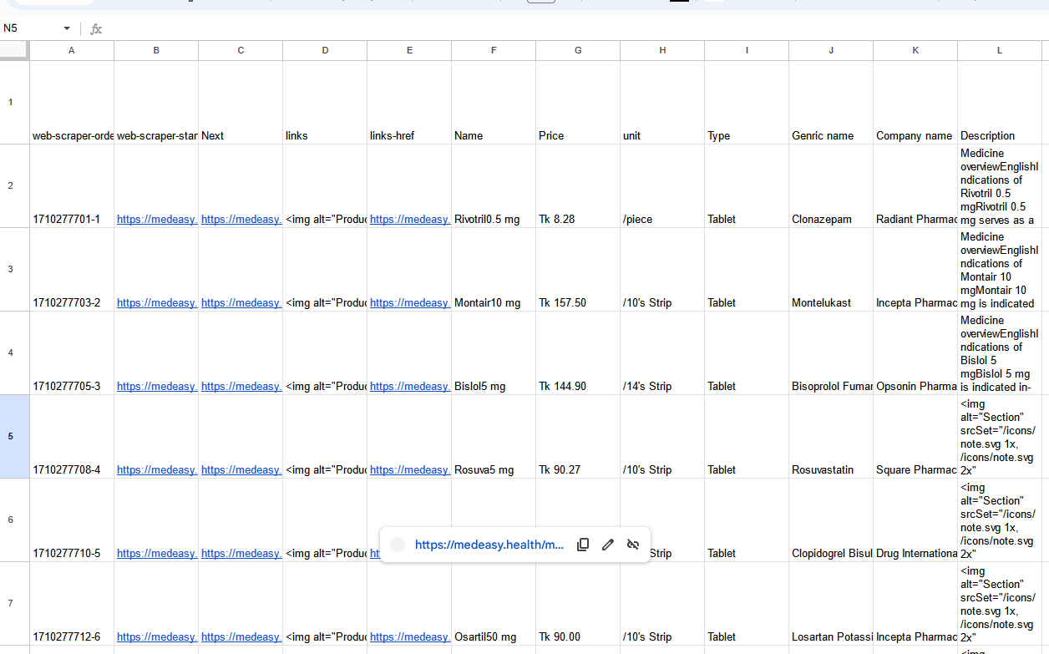
Glimpse of the Dataset:

Slide 4
Dataset collection:
Collected medical data from medeasy website
Dataset contains general information about pharmaceutical drugs and their usage
Cost of any medicine
It took 9 hours to scrap the data

Slide 5
Background Research:
Healthcare Landscape in Bangladesh:
Overview of healthcare system structure and accessibility.
Challenges including limited access, affordability, and infrastructure issues.
Role of Technology in Healthcare:
Exploration of chatbots' role in addressing healthcare challenges globally.
Discussion on their effectiveness and acceptance in providing medical information and support.
Medicine Pricing and Availability:
Investigation into medicine pricing factors, regulations, and distribution networks.
Highlighting disparities in pricing across regions and urban-rural areas.
Data Collection from Medeasy:
Explanation of dataset scope, relevance, and collection process.
Addressing challenges encountered and strategies for ensuring data accuracy.
Estimation of Medicine Expenses:
Methodology for estimating medicine expenses based on collected dataset.
Discussion on algorithms or models used for cost calculation.
Patient Education and Medication Management:
Importance of patient education in medication management.
Role of chatbot in providing information on dosage, frequency, and side effects.

Slide 6
Literature Review:
Enhancing Document Accessibility and Context-Aware Search Capabilities with V3CTRON Data Retrieval System
Semantic Search and Retrieval Capability:
V3CTRON employs BERT and Dense Retriever models for precise, context-aware search, surpassing traditional algorithms for improved relevance from private document collections.
Integration with Vector Databases:
V3CTRON integrates with providers like Milvus, LlamaIndex, and Qdrant, offering flexible storage options with various indexing algorithms and deployment choices for diverse user needs.
Versatile API and Cloud Infrastructure:
Users interact via FastAPI APIs, enabling functions like upserting, querying, and deletion. Installation on cloud infrastructures like Docker supports services such as Fly.io, Heroku, and Azure Container Apps, with continuous data processing for an updated search experience.

Slide 7
Improve Transformer Models with Better Relative Position Embeddings
Optimizing Relative Position Embeddings:
The research aims to enhance Transformer models by optimizing relative position embeddings, expecting improved generalization, accuracy, and performance, particularly for tasks like passage ranking and question answering.
Novel Strategies for Self-Attention Improvement:
The primary contribution offers new strategies for relative position embeddings, aiming to increase self-attention interactions within Transformer models for better correctness and efficiency.
Broad Application and Future Research:
Findings indicate optimized relative position embeddings improve Transformer performance for tasks like passage ranking and question answering. While empirical evidence is strong, more theoretical exploration could enhance understanding. Expanding assessments across tasks and datasets could provide a broader view of these methods' efficacy for various NLP applications, suggesting potential for advancements in language understanding tech across fields.

Slide 8
Parameter-Efficient Sparse Retrievers and Rerankers using Adapters
Adapters for Neural Retrieval Models:
Adapters are investigated as an affordable solution to train models like SPLADE for Information Retrieval, aiming to enhance efficacy and efficiency in tasks like domain adaptation.
Methodology and Findings:
The study examines adapter layers, knowledge transfer strategies, and adapter performance, showing adapters as a practical substitute for full fine-tuning, improving efficiency and generalizability.
Implications and Limitations:
Adapters show promise for improving retrieval processes, providing rapid domain adaptation, and enhancing multi-stage retrieval systems. However, the study's focus on SPLADE limits direct applicability to other models, suggesting further research for broader insights.

Slide 9
RankVicuna: Zero-Shot Listwise Document Reranking with Open-Source Large Language Models
First Open-Source Big Language Model for Reranking:
RankVicuna is the first open-source big language model for zero-shot listwise document reranking, providing a clear method to overcome issues with proprietary models and achieving similar efficacy to GPT 3.5 with a lower 7B parameter model.
Promoting Openness and Cooperation:
RankVicuna emphasizes the importance of open-source models for research accuracy, offering researchers access to model checkpoints and code for duplication and improvement.
Innovative Document Reranking Technique:
RankVicuna's development highlights insights into first-stage retrieval techniques and data-driven training for improved language model performance, contributing to the field of information retrieval research and promoting open scientific techniques.

Slide 10
Thank You

